Slide 1

Phish Hunter
An educational cybersecurity game
Team: Tech Support University: UKZN Members: Jashvin Pandoo, KEEgan BRown

Slide 2



Lack of cybersecurity awareness
WHY?

Slide 3
Need for transparency
The creators of this game felt that it would be good to educate people on cybersecurity by taking themes such as passwords, phishing scams, and cryptography, and conceptualizing them into a simple, and concise game that can help them to understand how important it is to be secure in the digital space.
There are problem-solving questions that will have the player engage and introduce them to very basic ideas of cybersecurity.

Slide 4


Goal?
Better understanding of cybersecurity practices.

Slide 5
A better understanding of Cybersecurity will improve security in many different fields
Banking
Online payments
Social media
Healthcare systems
Government systems
Smart devices

Slide 6
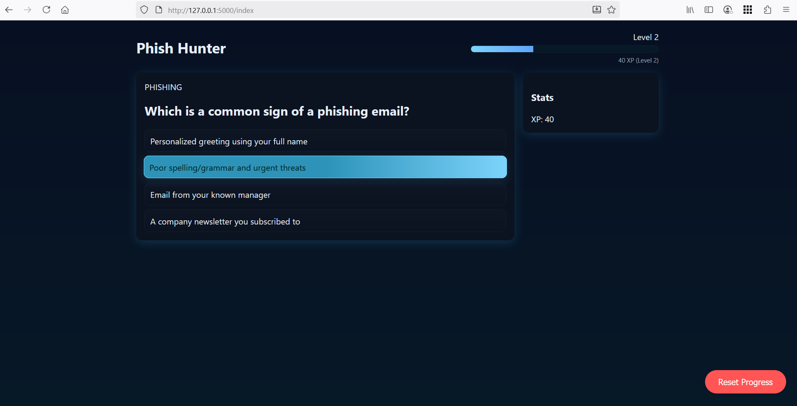
Implementation
Browser-Based build using
Python, Flask
JavaScript, html, css

Slide 7

Thank you

